Slide 1
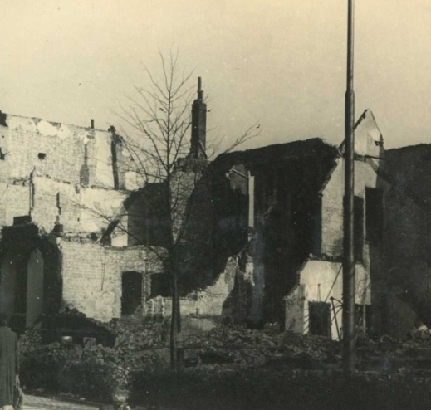
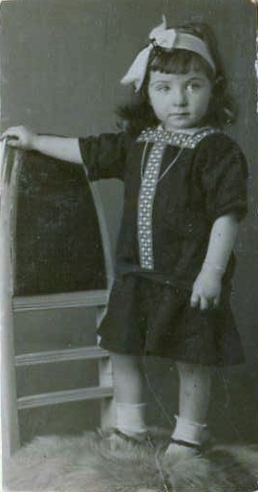
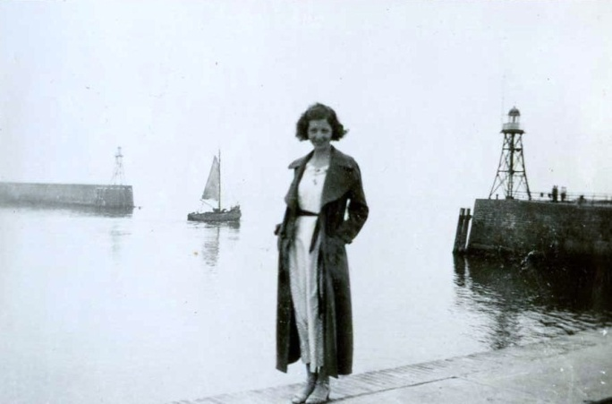
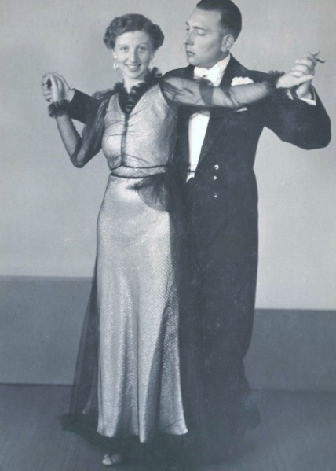
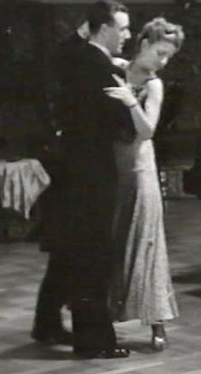
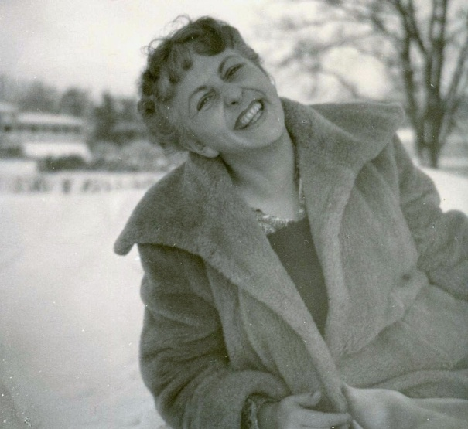
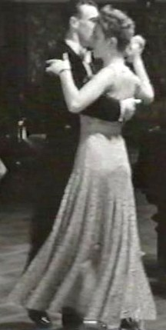
A selection of pictures from the book
After the war, Rosie recovered her picture albums that were buried in the backyard of her ruined home
Rosie’s ruined home in 1947
By the harbor in The Hague 1936
Rosie in 1916 - age 2
Rosie in Sweden, 1951
Rosie with husband Leo who betrayed her, 1937
Demonstrating a new dance on cinema news, 1940

Slide 2
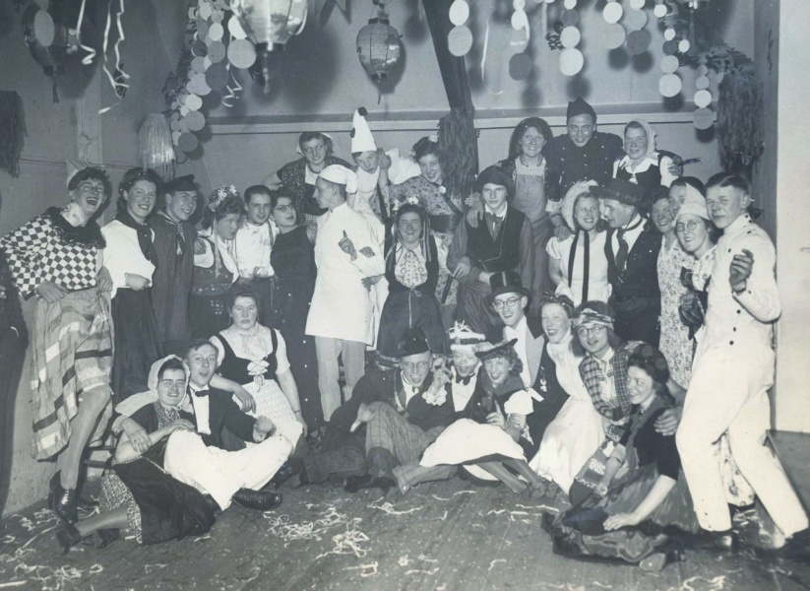
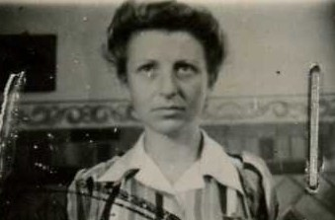
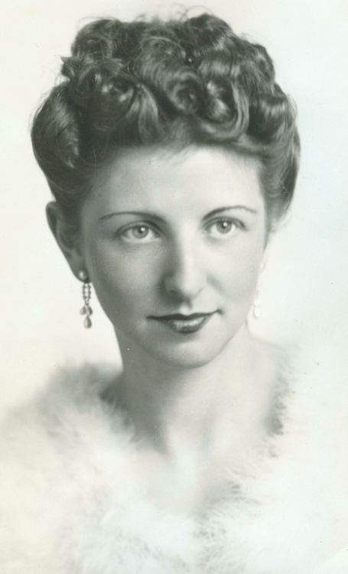
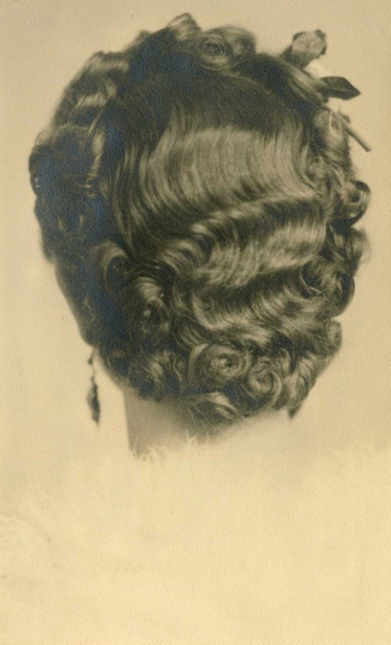
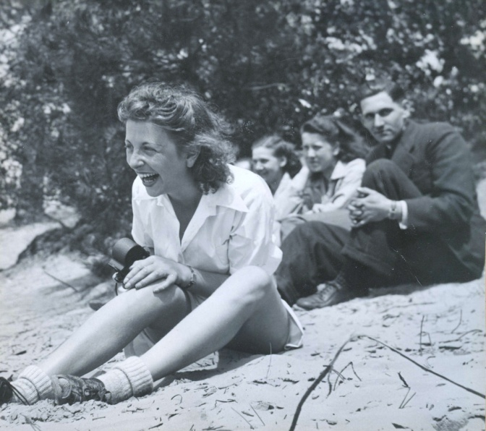
A selection of pictures from the book
After the war Rosie digs up pictures buried in the backyard of her ruined house
Freedom following her exchange for three German POWs in 1945
Party at Rosie’s illegal attic dance school, 1942
Dance school day out 1942
Rosie 1941

